Slide 1
ARCHIVER
Archiving and Preservation for Research Environments
Information Session Webinar
18 March 2020
João Fernandes – ARCHIVER Project Coordinator (CERN)
Jakub Urban – ARCHIVER Technical Coordinator (CERN)
Joshua Luke Davison – ARCHIVER Procurement Officer (CERN)

Slide 2

Agenda for today
Key Updates / Technical Questions and Answers
  João Fernandes (CERN)
  Jakub Urban (CERN)
Procurement Questions and Answers
  Joshua Luke Davison (CERN)

Slide 3
Deadline Extension
The deadline for submission of Tenders is extended to 14 April 2020 at 4 pm (Geneva time)
An updated project timeline is available on the website

Slide 4
Impact of Brexit
One of the PCP requirements stipulates that a majority of the R&D carried out under the PCP Contract must be in EU Member States or Horizon 2020 Associated Countries
For ARCHIVER, the United Kingdom is considered as being one of these countries

Slide 5
Technical Questions
Scope of the R&D vs. Consortium members and roles
Requirements per Phase (Design, Prototype, Pilot)
Network Connectivity Options
Testing Methodology
Specific Questions about the some of the Use Cases

Slide 6
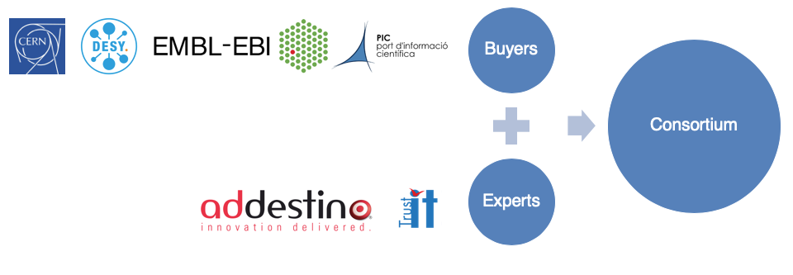
Consortium
Includes Buyers and Experts in the preparation, execution and promotion of the
procurement of R&D services
Procurers - Public organisations committing funds to contribute to a joint-R&D-procurement, research data use cases and R&D testing effort
Buyers
Buyers
Experts – Partner organisations bringing expertise in requirement assessment and promotion activities, not part of the Buyers Group
Consortium
Consortium
Experts
Experts

Slide 7












Early Adopters
Participants:
  Demand side public sector organisations
Information Webinar (04th September) = 47 participants
Key advantages
  Assess if resulting services address archiving and preservation needs
  Contribute and shape the R&D carried out in the project, contribute with use cases and have the option to purchase pilot-scale services by the end of the project
Confirmed subscription received from 11 organisations:
High level of interest from the community

Slide 8
Outcome: R&D Challenge
Layer 4
Advanced services
Cost-effective Business Model
Taking into account:
Scale
Ingest rates
Archive lifetime
# of copies
Exit strategies
Portability
SLAs
Regulation & Legislation
Auditing
Self-assessment
Data Retention
GDPR
High level services: visual representation of data (domain specific), reproducibility of scientific analyses using K8, ML, etc.;
Bonus
R&D
Layer 3
Baseline user services
User services: search, discover, share, indexing, data removal, etc.;
Access under Federated AAI
Layer 2
Preservation
OAIS conformant services: data readability formats, normalization, obsolesce monitoring, files fixity, authenticity checks, etc.;
ISO 14721/16363, 26324 and related standards
Core
R&D
Layer 1
Storage/Basic Archiving/Secure backup
Data integrity/security; cloud/hybrid deployment; data volume in the PB range; high, sustained ingest data rates;
ISO certification: 27000, 27040, 19086 and related
Archives connected to the GEANT network.
Scientific use cases deployments documented at: https://www.archiver-project.eu/deployment-scenarios

Slide 9
Examples of Tenderer arrangements
Case 1: Minimum 2 consortium companies
  Infrastructure Provider (PB), typically addressing Layer 1
  Data Preservation Software Provider (Layer 2/3)
    Layer 4 will depend on how well integrated these two are and where the real innovation will be
  Role of consortium lead: either one of the above companies or a third company
Case 2: Only one company
  Archiving and Preservation Software provider (Y) that subcontracts to an infrastructure provider (PB);
    Layer 1-4 applies as in case 1
  Y needs to accumulate the role of coordinating its subcontractors’ activities

Slide 10

ARCHIVER Contractual Relationship
“Buyers Group”:
Funds, Use Cases, Testing Effort
Competitive, public/private R&D partnerships for archiving and preservation services at scale
Contractual Relationship
Providers of R&D services; Prod solution by the end of ARCHIVER
Consortium 1
Consortium 2
Consortium 3
Consortium N
…
Consortium members and subcontractors are autonomous in establishing their internal relationships
Contractual relationship is between CERN, on behalf of the Buyers group (CERN, EMBL, DESY and PIC), and the single or lead contractor (on behalf of the other consortium members).

Slide 11
Capacity per Phase
Phase 1 - Architecture
Test only on the current state-of-the-art (Demo versions)
  Capacity for all testing needed less than 100TB storage
  Testing Methodology to be ”tested”:
    Provision of the framework with one example test to deploy (Network test)
    Provision of accesses to the testing environment for relevant members of the Contractor Teams
Phase 2 – Prototype
Functional testing starts
  To be specified at call-off time
  Capacity to be staged during the phase from several hundreds of TB to < 1PB
Phase 3 – Pilot
Performance testing starts
  To be specified at call-off phase
  Staged PB capacity performance and scalability capabilities (no more than 5PB)
  Exit strategies and portability will be of utmost relevance

Slide 12
Network Connectivity
Why connecting to GÉANT?
  Minimise network charges for research and education institutions as traffic charges (e.g. egress charges from service providers) for the provision of data intensive services.
How to connect to GÉANT?
  Via an NREN, to an NREN PoP location.
  Direct connection to GÉANT at one or more of its PoP locations
  Connection at a GÉANT Open Exchange (London, Paris)
  Direct connection at one of the following Internet Exchanges (Amsterdam, London, Vienna, Frankfurt, Milan)
The connection will incur a cost. Costs are eligible as part of the bid (Annex 5)
Process starts by contacting: researchengagement@geant.org
Important Notes:
  Requirement: to peer at the required bandwidth (Prototype and Pilot Phases) to the GÉANT network NOT to each of the Buyers Data Center locations
  The peering between the Tenderer and the GÉANT network will be a dedicated, private interconnection
  The Buyers Group except at least the concrete plans for connectivity to be in place and communicated during the Design Phase
    Realistically, do not underestimate the time required. GÉANT is NOT a commercial operator.
The Buyers Group will consider alternative connections to GÉANT
  In this case, the Tenderer must elaborate on details concerning the network connectivity options available offering equivalent service features. Details must include information about egress/ingress charges.

Slide 13
Architecture principles of the Testing Methodology
Platform independent
Broad Support
Isolated
Configurable
Documented
Abstracted
Modular
Adjustable
Accessible
Open source

Slide 14
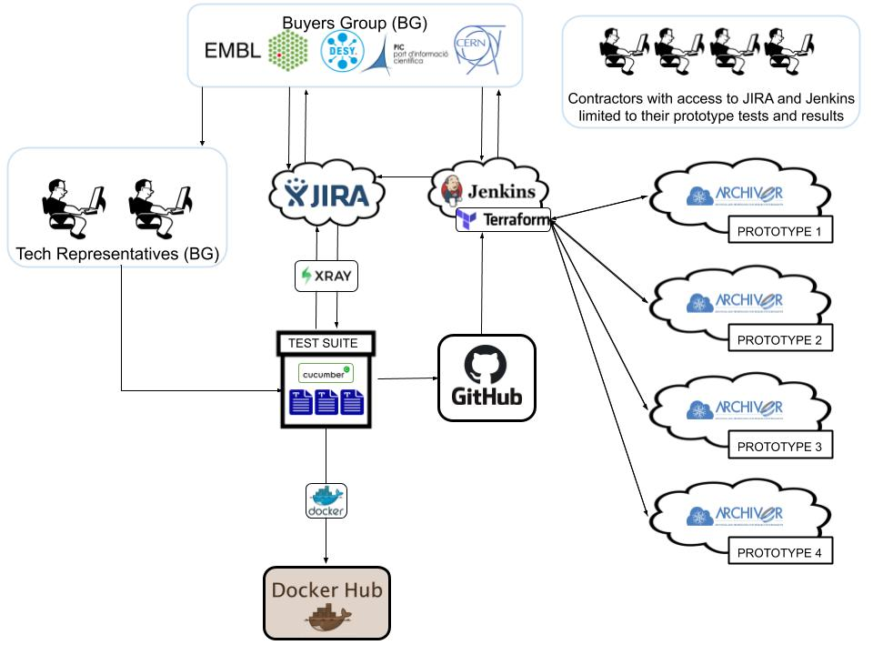
Continuous Testing Environment

Slide 15
Testing Process
Tests provided by the Buyers Group
Test plan to be co-designed with Contractors
Allow Contractors to make autonomous tests
  Using the Test Suite
  Be immediately notified in case of failures, before exposing the members of the Buyers Group to testing activities
Confidentiality of test results will be assured
Test assessment: deciding factor to qualify solutions for the subsequent phases

Slide 16
Testing timeline
2nd EC review
(Nov)
Project Ends
(Dec 2021)
Tender Publication
(31 Jan)
Tender Closure
(14 April )
Results
(30 April)
Contracts Signed
(22 May)
Non-Functional Testing
Test Suite Development
Buyers Group documenting Test Plan & Methodology
Functional Testing
Design Phase
4 Months
Prototype Phase
5.5 Months
Pilot Phase
4.5 Months
Call Off
Call Off
January
2020
25 May
2020
25 Sept
2020
23 Nov
2020
January
2021
14 May
2021
12 July
2021
30 Nov
2021
Info Sessions
(07 February & 18 March)

Slide 17
Selected bidders will have opportunities to discuss and refine the testing process during the Design Phase

Slide 18
Procurement Questions
Scope of the PCP and domains of application
Commercialisation of Results
Virtual price and actual price in the Tender evaluation process

Slide 19
Scope of the PCP
The ARCHIVER PCP Contracts (for Phases 1, 2 and 3) concern the procurement of R&D services
During the PCP, the Buyers Group will provide first customer feedback, test set-ups, and data for testing (from the deployment scenarios described in the Functional Specifications). The R&D will be done in close contact with the four Buyers.
However, the services developed during the PCP (i.e. the Results) are expected to be applicable to research domains beyond those of the four Buyers.

Slide 20
Commercialisation of the Results
The Results are owned by the Contractor and are expected to be commercialized after the end of the PCP:
  The RfT contains information about the possible future market;
  The buyers have foreseen the option to purchase pilot-scale services after the end of the PCP;
  There is a growing list of early adopters interested in following the PCP and potentially purchasing the Results.

Slide 21
Commercialisation of the Results
The evaluation of the Tenders takes into account the Tenderer’s future commercialization of the Results in several ways:
  The Tenderer must demonstrate competence needed to commercialise and protect the Results;
  Tenders will be scored on the proposed commercialization plan for the Results;
  Tenders will be scored based on the degree to which the total cost of the future services is considered by design and based on the future SLA applicable to the services;

Slide 22
Intellectual Property Ownership
Buyers Group
Background IP
Sideground IP
Framework Agreement
Results
Time
Contractor (you)
Background IP
Sideground IP
Signature of the Framework Agreement
End of the Framework Agreement

Slide 23
Intellectual Property Ownership (Traditional R&D Contract)
IP owned by the Buyers Group
Buyers Group
Background IP
Sideground IP
IP owned by the contractor
Framework Agreement
Results
Time
Contractor (you)
Background IP
Sideground IP
Signature of the Framework Agreement
End of the Framework Agreement

Slide 24
Intellectual Property Ownership (PCP Contract)
IP owned by the Buyers Group
Buyers Group
Background IP
Sideground IP
IP owned by the contractor
Framework Agreement
Results
Time
Contractor (you)
Background IP
Sideground IP
Signature of the Framework Agreement
End of the Framework Agreement

Slide 25
Virtual Price v Actual Price
Costs
100%
Virtual Price
(i.e. price payable in case of “exclusive development”)
Difference
Actual Price
(i.e. price payable under PCP contract)
0
The virtual price is: the price payable that would be payable in a situation of exclusive development. It reflects ALL the costs incurred by the contractor in its performance of the PCP Contract.
The difference between the virtual and actual prices must be sufficient to preclude State Aid.
The actual price is used to establish the price score for the Tender.

Slide 26
ARCHIVER Request for Tenders: Key Dates
30 January 2020: Publication date
7 February 2020: First information session
10 March 2020: Deadline for requesting clarification
18 March 2020: Second information session and deadline for responses to clarifications
14 April 2020 4pm Geneva time: Deadline

